Slide 1


NEXT GEN EMPLOYABILITY PROGRAM
CREATING A FUTURE-READY WORKFORCE
Student Name :
MANOHAR REDDY PARNE
Student ID :
College Name :
STU669f880723bee1721731079
Malla Reddy university

Slide 2
CAPSTONE PROJECT SHOWCASE
Project Title
AUCTISM
Abstract | Problem Statement | Project Overview | Proposed Solution | Technology Used | Modelling & Results | Conclusion | Q&A

Slide 3
Abstract
1
Introduction: Auctism is an online auction platform designed to facilitate seamless and interactive bidding. It enables users to participate in auctions, place real-time bids, and engage in a secure and transparent auctioning process.
2
Key Features: The platform includes secure user authentication, auction registration, real-time bidding with WebSocket integration, a countdown timer for auction status, an interactive image gallery, and dark mode support for enhanced user experience
3
Technology Stack: Built using the MERN stack (MongoDB, Express.js, React.js, Node.js), Auctism incorporates WebSockets for live bid updates, AWS S3 for image storage, and JWT-based authentication for security
4
Objective: The project aims to enhance digital auction systems by integrating modern web technologies, real-time functionalities, and a user-friendly interface, ensuring a smooth and secure auction experience.

Slide 4


Problem Statement
Delayed Bid Updates – Slow refresh rates in traditional auction platforms cause users to miss timely bidding opportunities, impacting competitiveness.
Security Vulnerabilities – Inadequate authentication measures expose systems to fraud, risking user data and platform integrity.
Inefficient Auction Management – Current systems often lack seamless auction registration, real-time bid tracking, and effective lifecycle management, leading to operational inefficiencies.
Low User Engagement – The absence of dynamic features such as live countdowns and interactive image galleries reduces user participation and satisfaction.
Limited Scalability – Many platforms are unable to handle a surge of simultaneous users and bid transactions, resulting in performance bottlenecks.
Poor System Responsiveness – Inconsistent data synchronization and lag in real-time updates detract from the seamless auction experience users expect.

Slide 5

Project Overview
Dedicated Online Auction Platform – Auctism is designed solely for conducting online auctions, enabling users to bid on products in a competitive and transparent environment.
MERN Stack Implementation – Developed with MongoDB, Express.js, React.js, and Node.js, the project ensures a modern, scalable, and maintainable web application architecture.
Real-Time Bidding System – Utilizing WebSocket technology, the platform provides live bid updates, allowing for instantaneous feedback and dynamic auction participation.
Interactive User Interface – The application features an engaging UI with an interactive image gallery and a live countdown timer to highlight auction timings and maintain user excitement.

Slide 6
Secure Authentication and Access – Implementing robust user authentication methods, including JWT-based access control, ensures that only authorized users participate in auctions.
Comprehensive Auction Management – From registration to bid tracking and auction closure, Auctism streamlines the entire auction process.
Compliance and Transaction Security – The platform mandates user agreement to terms and conditions before participation and integrates secure payment processing to protect all transactions.
Optimized User Experience – Every aspect of the project is tailored to offer a smooth, responsive, and engaging experience, directly addressing common challenges faced in traditional online auction systems.

Slide 7
Proposed Solution
Real-Time Bidding Integration
Incorporate WebSocket technology to enable live bid updates so that all participants see bid changes as they occur without delay.
MERN Stack Implementation
Develop the application using MongoDB for efficient data storage, Express.js and Node.js for backend services, and React.js to create a responsive, dynamic frontend.
Secure Authentication and Authorization
Implement JWT-based authentication to verify user identities and control access, ensuring that only registered and authorized users can participate in the auctions.
Interactive and Informative User Interface
Design an engaging UI that includes an interactive image gallery for product display and live countdown timers to clearly indicate auction start and end times.
Streamlined Auction Management
Provide a complete auction workflow that covers user registration, auction creation, bid submission, and auction closure—all within a single, cohesive system.

Slide 8
Technology used
MongoDB: NoSQL database for storing auction data and user profiles.
Express.js & Node.js: Backend framework handling API requests and business logic.
React.js: Frontend library for a dynamic and responsive user interface.
WebSocket: Enables real-time communication for live bid updates.
JWT-Based Authentication: Secures user sessions and access control.
Google Authentication: Provides an alternative secure login method.
AWS S3 Bucket: Manages secure storage and retrieval of auction images.

Slide 9
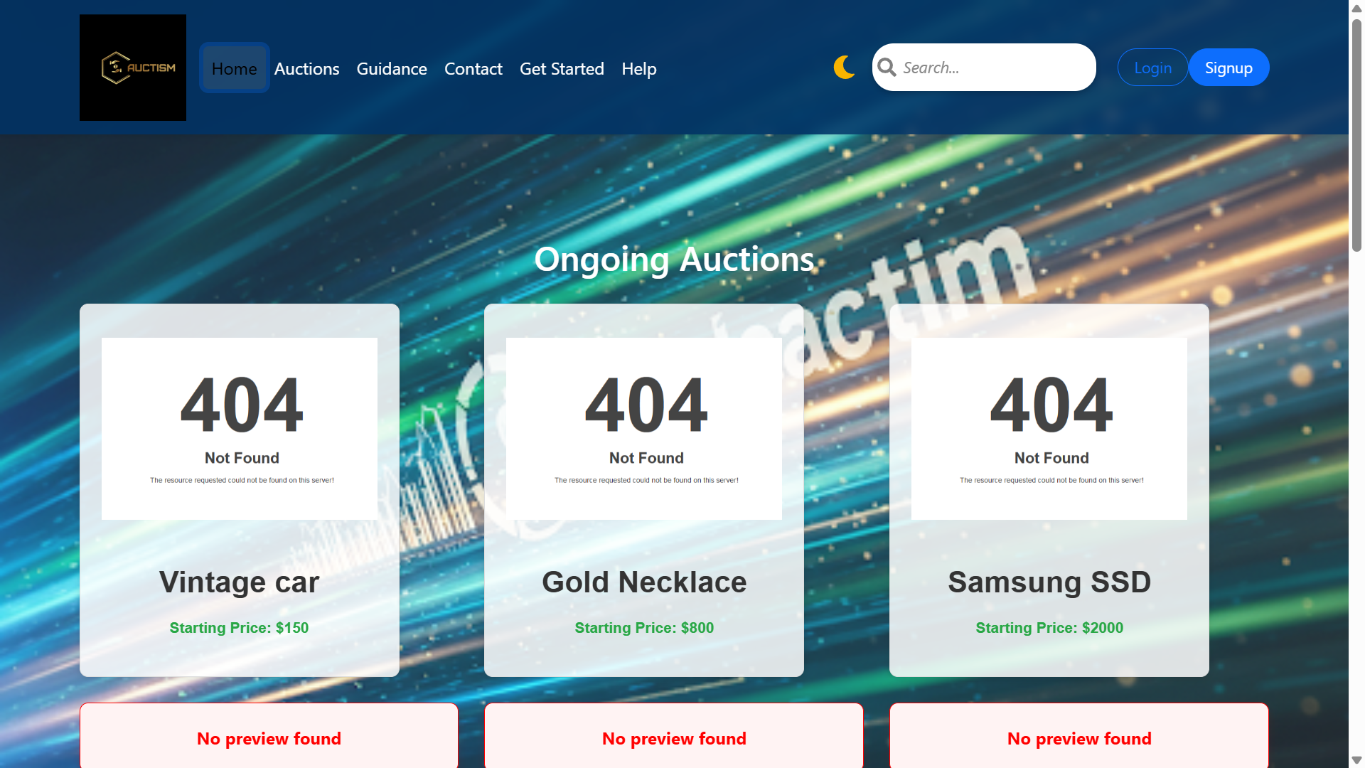
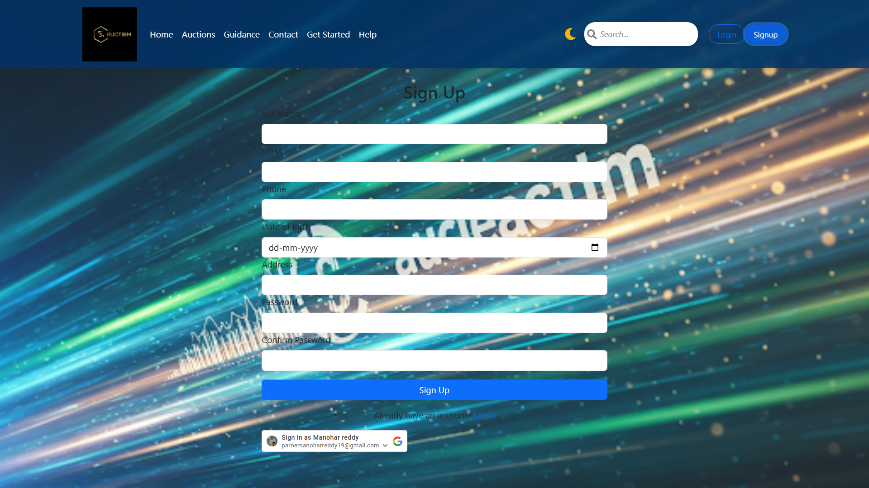
Modelling & Result
Fig 1: Default Dashboard
This screenshot shows the default dashboard where users view ongoing auctions. The navigation bar provides login and signup options.
Fig 2: Signup
This screenshot shows the signup page where new users register for the platform

Slide 10
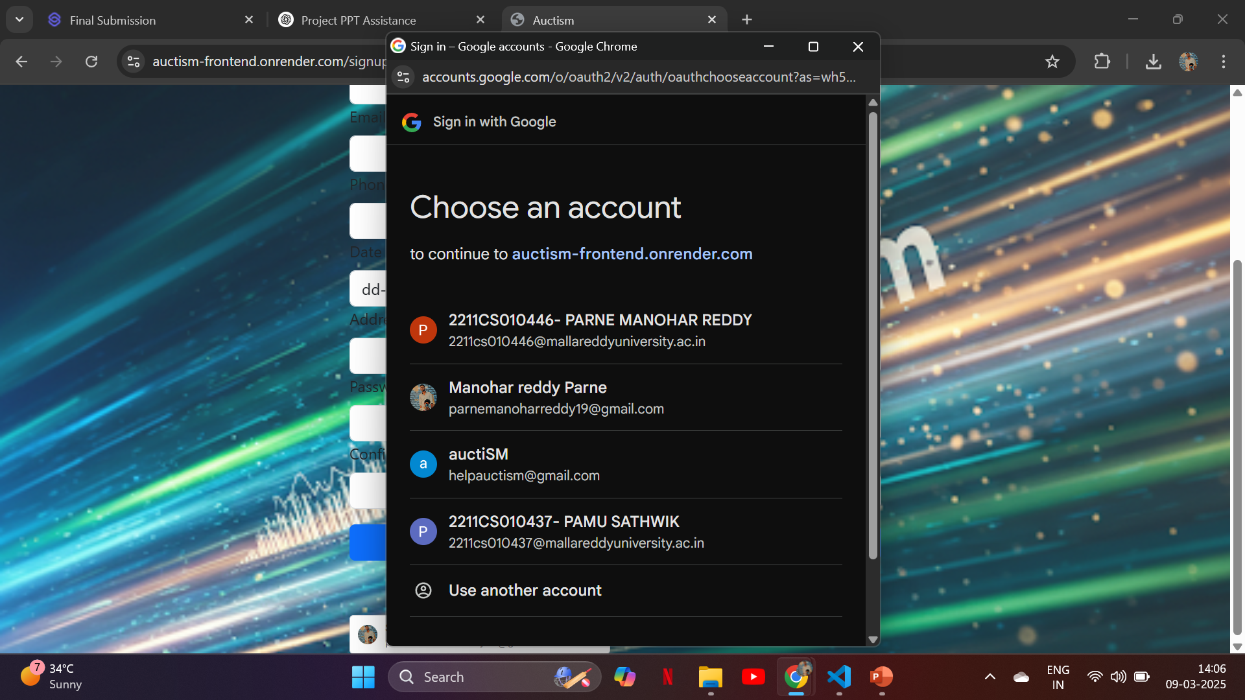
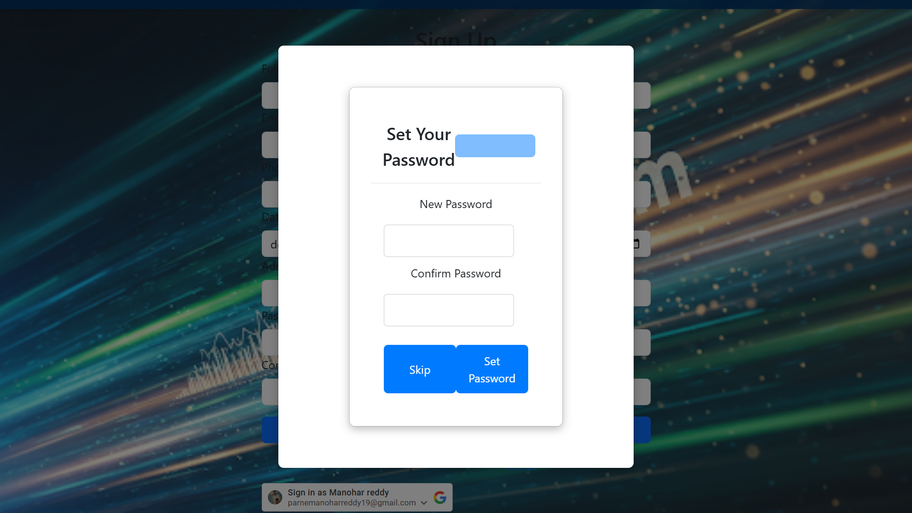
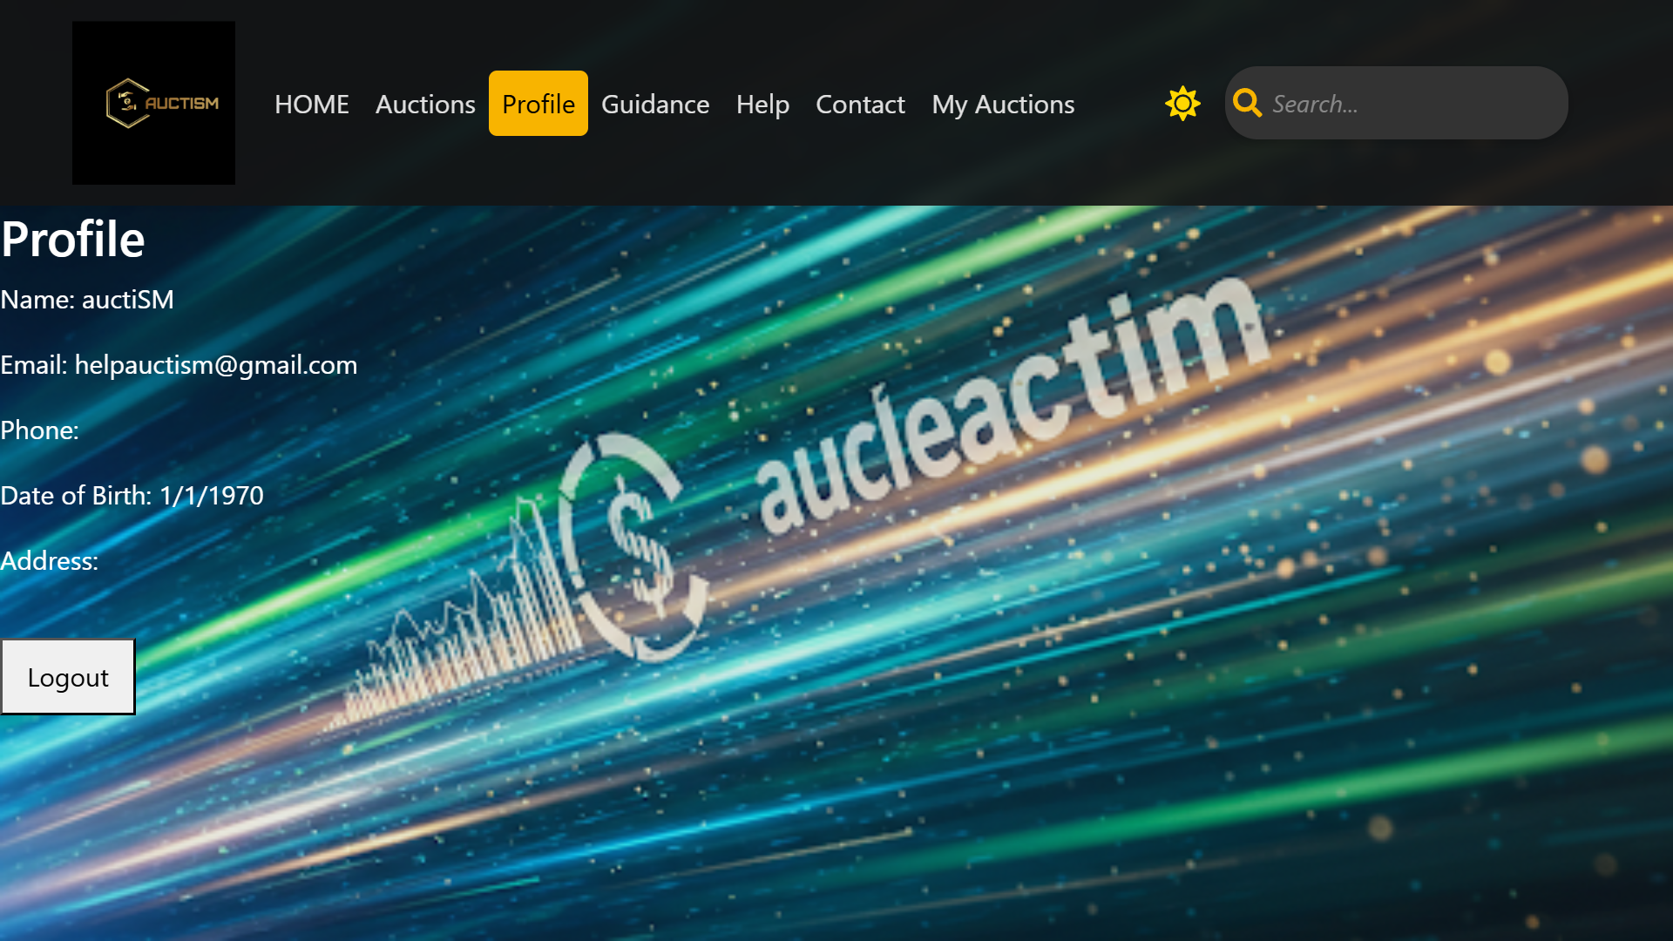
Fig 3: Google Signup
This screenshot clicks on "Signup with Google" and selecting an account.
Fig 4: Password Setup Modal
This screenshot shows the modal for setting a password after selecting the account.
Skip/set password for manual login.
Fig 5: User Dashboard - Profile Section
This screenshot shows the user dashboard's profile section after the password is saved.

Slide 11
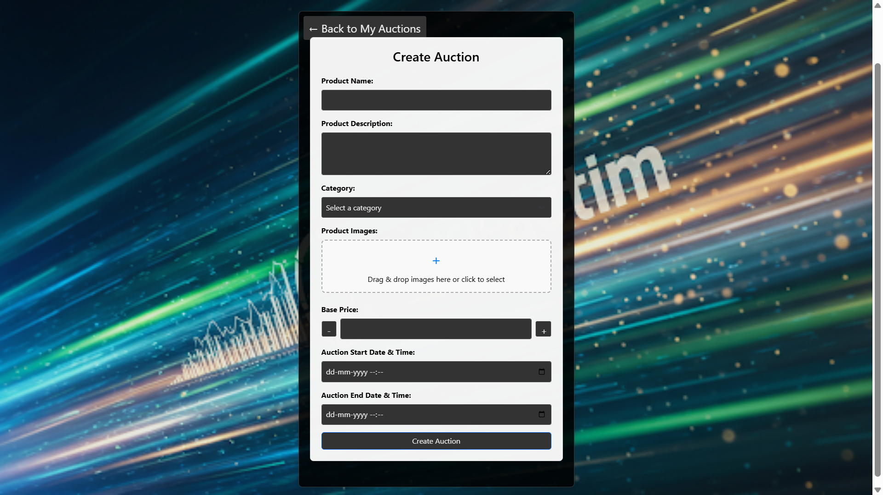
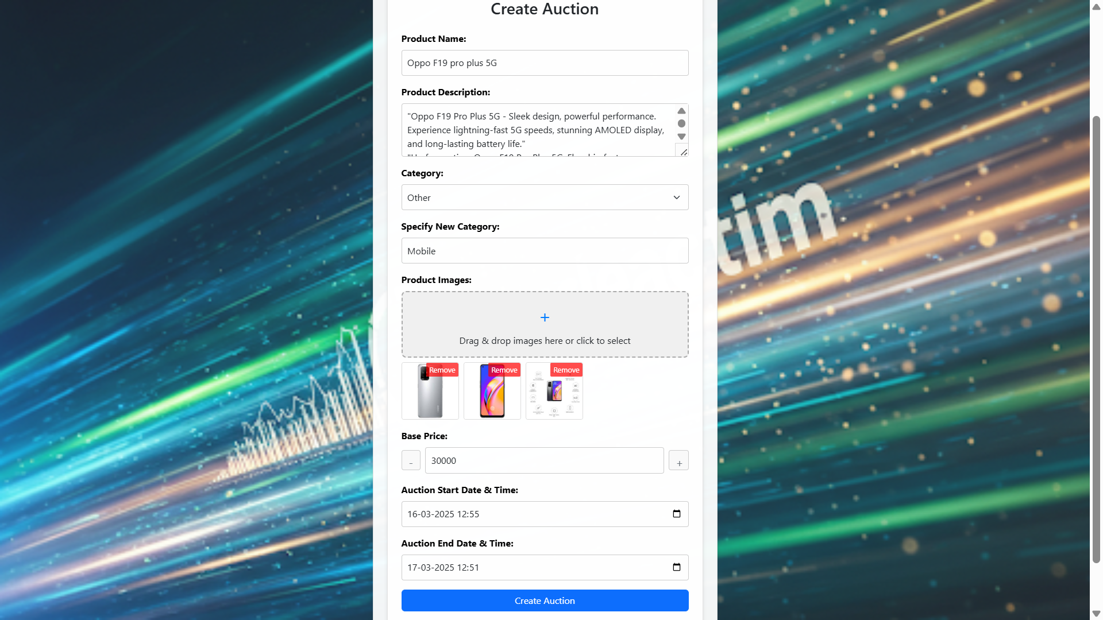
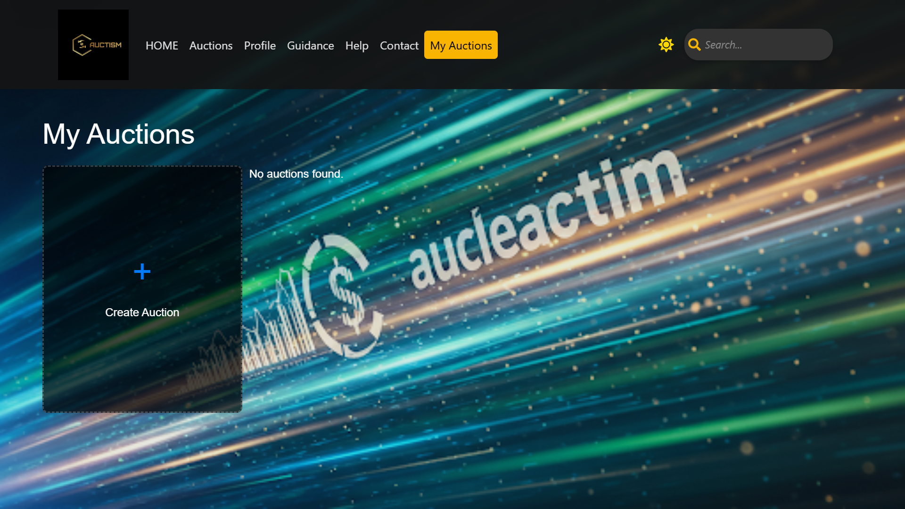
Modelling & Result
Fig 6: My Auction Tab
This screenshot displays the My Auction tab, where users can create an auction.
Fig 7: Create Auction Page
This screenshot shows the Create Auction page with the auction creation form.
Fig 8: Auction Creation Confirmation
This screenshot shows the confirmation after clicking the Create Auction button.

Slide 12
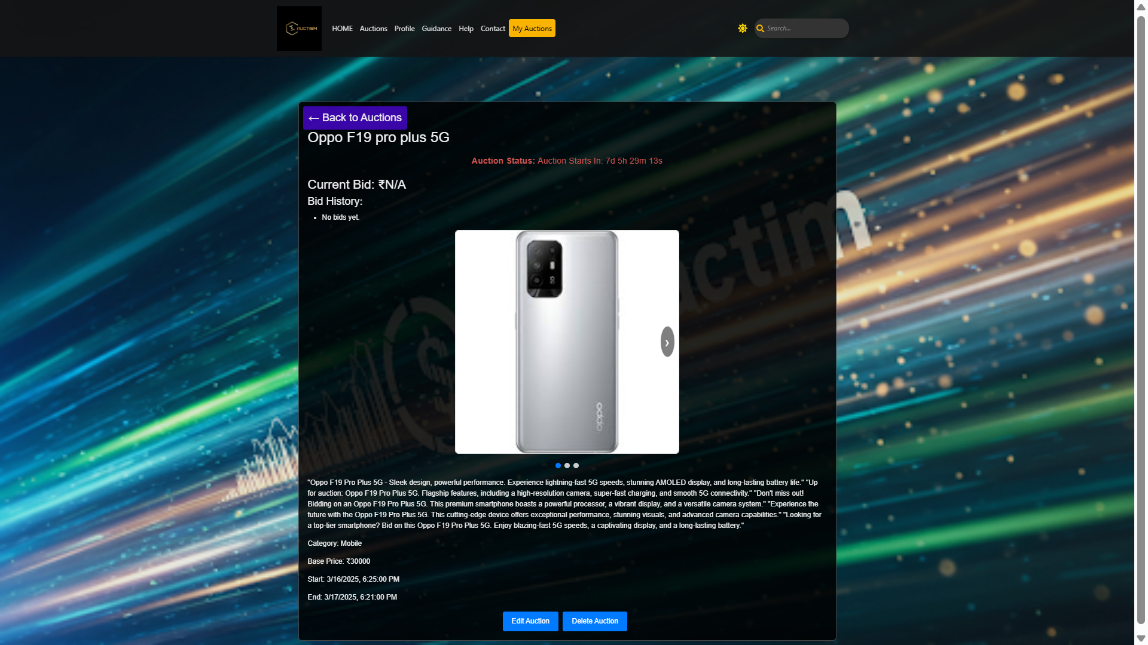
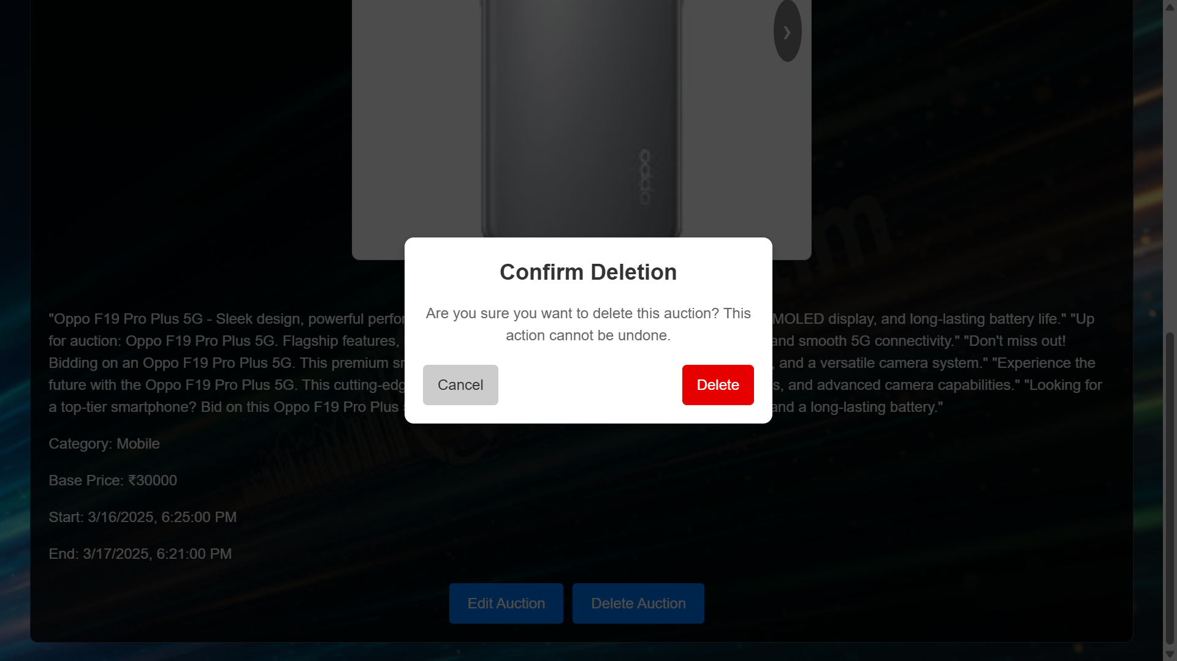
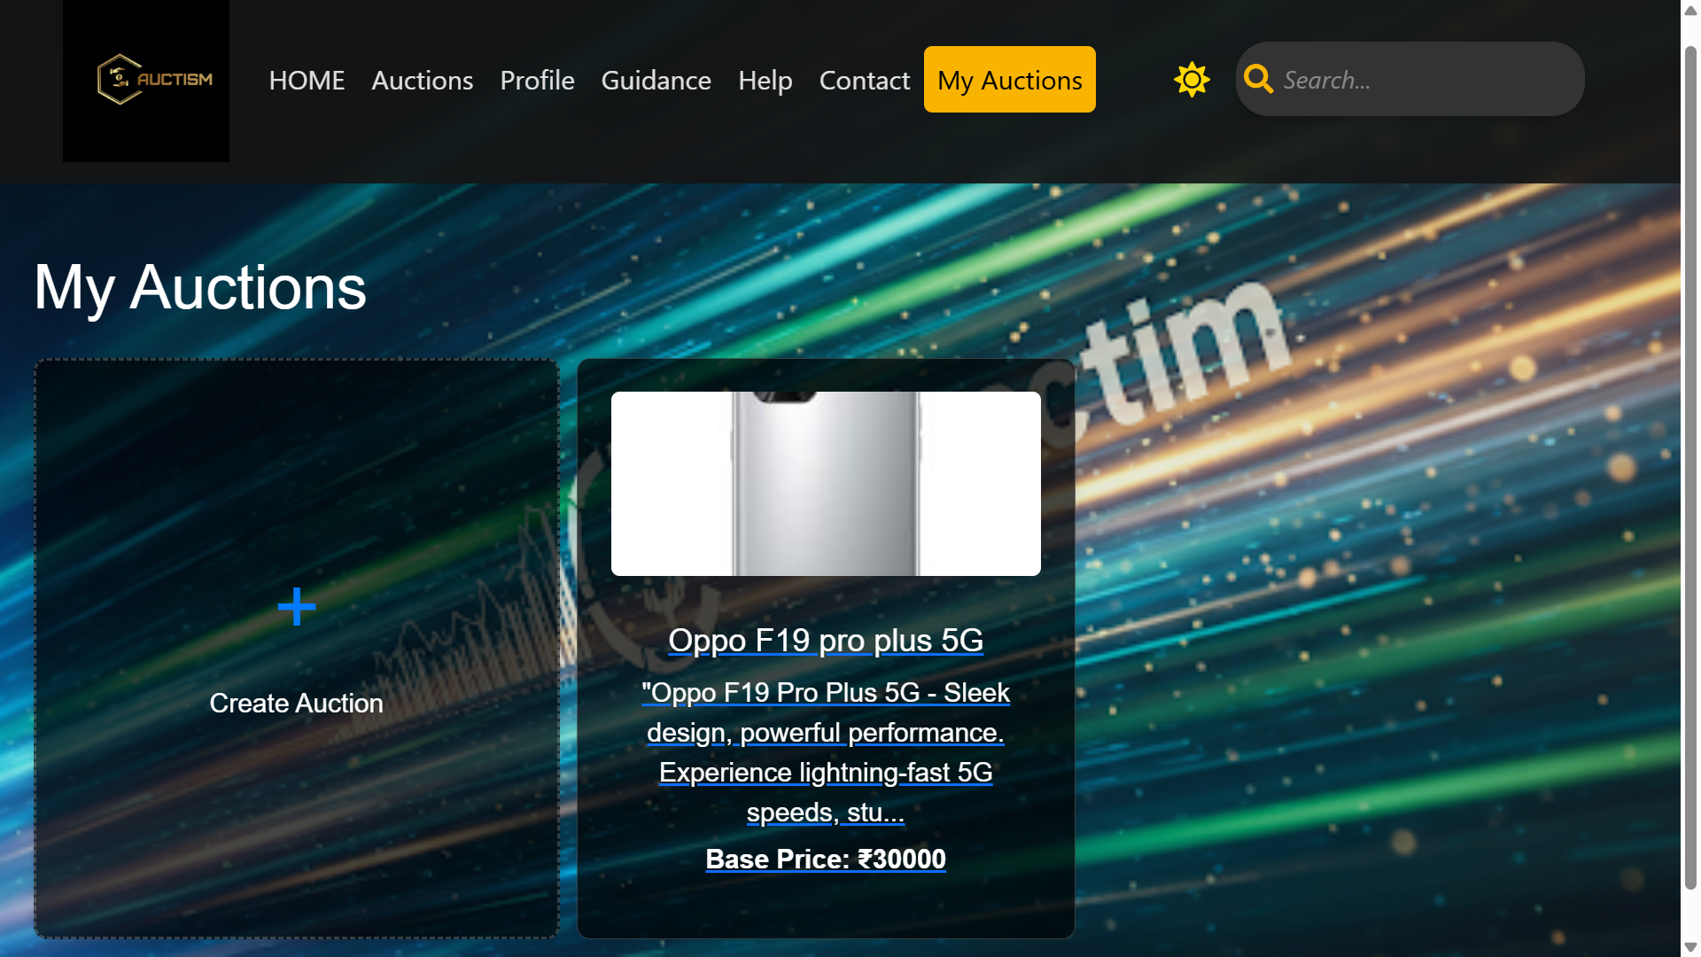
Modelling & Result
Fig 10:Delete Auction
This screenshot shows that user can delete on Modal.
Fig 11: My Auctions Tab
This screenshot shows all auctions created by the user in the My Auctions tab.
Fig 9: Created Auction Detail View
This screenshot displays the detailed view of the created auction. User can edit/delete the auction.

Slide 13
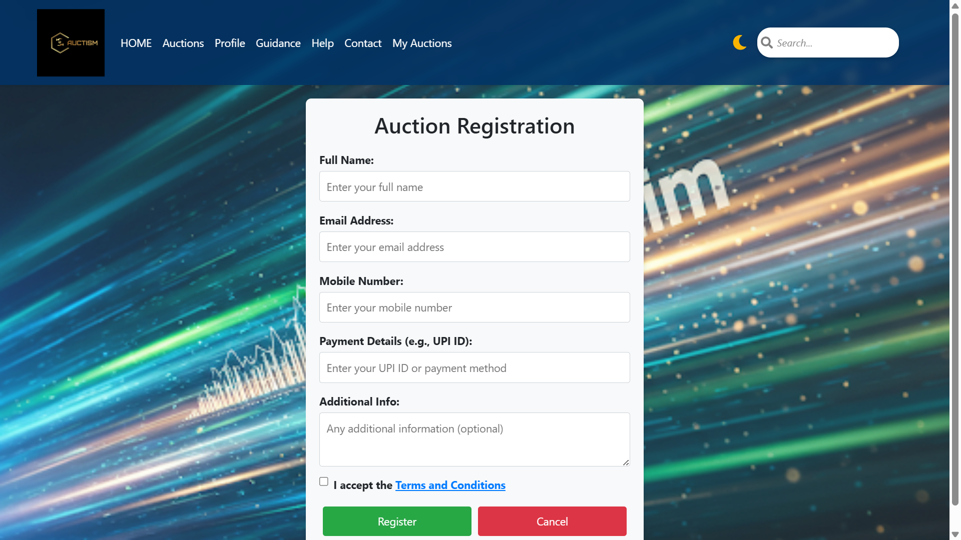
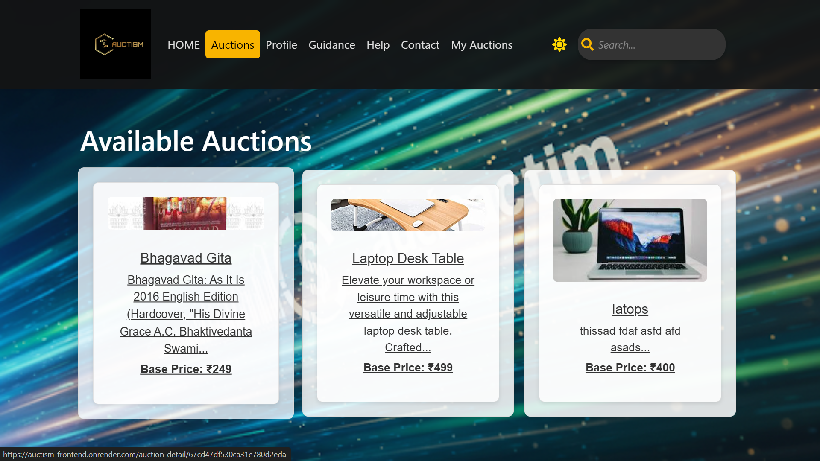
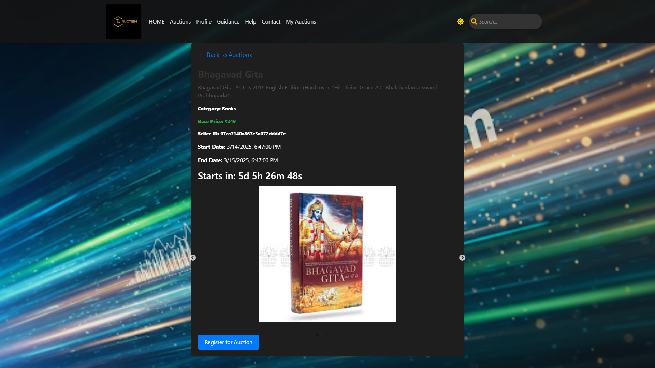
Modelling & Result
Fig 12: Auctions Tab
This screenshot shows the auctions tab, displaying auctions created by other users.
Fig 13: Auction Item Detail View
This screenshot shows the detailed view of an item after clicking on it.
Fig 14: Auction Registration Page
This screenshot shows the detailed view where clicking the register button directs the user to the auction registration page.

Slide 14
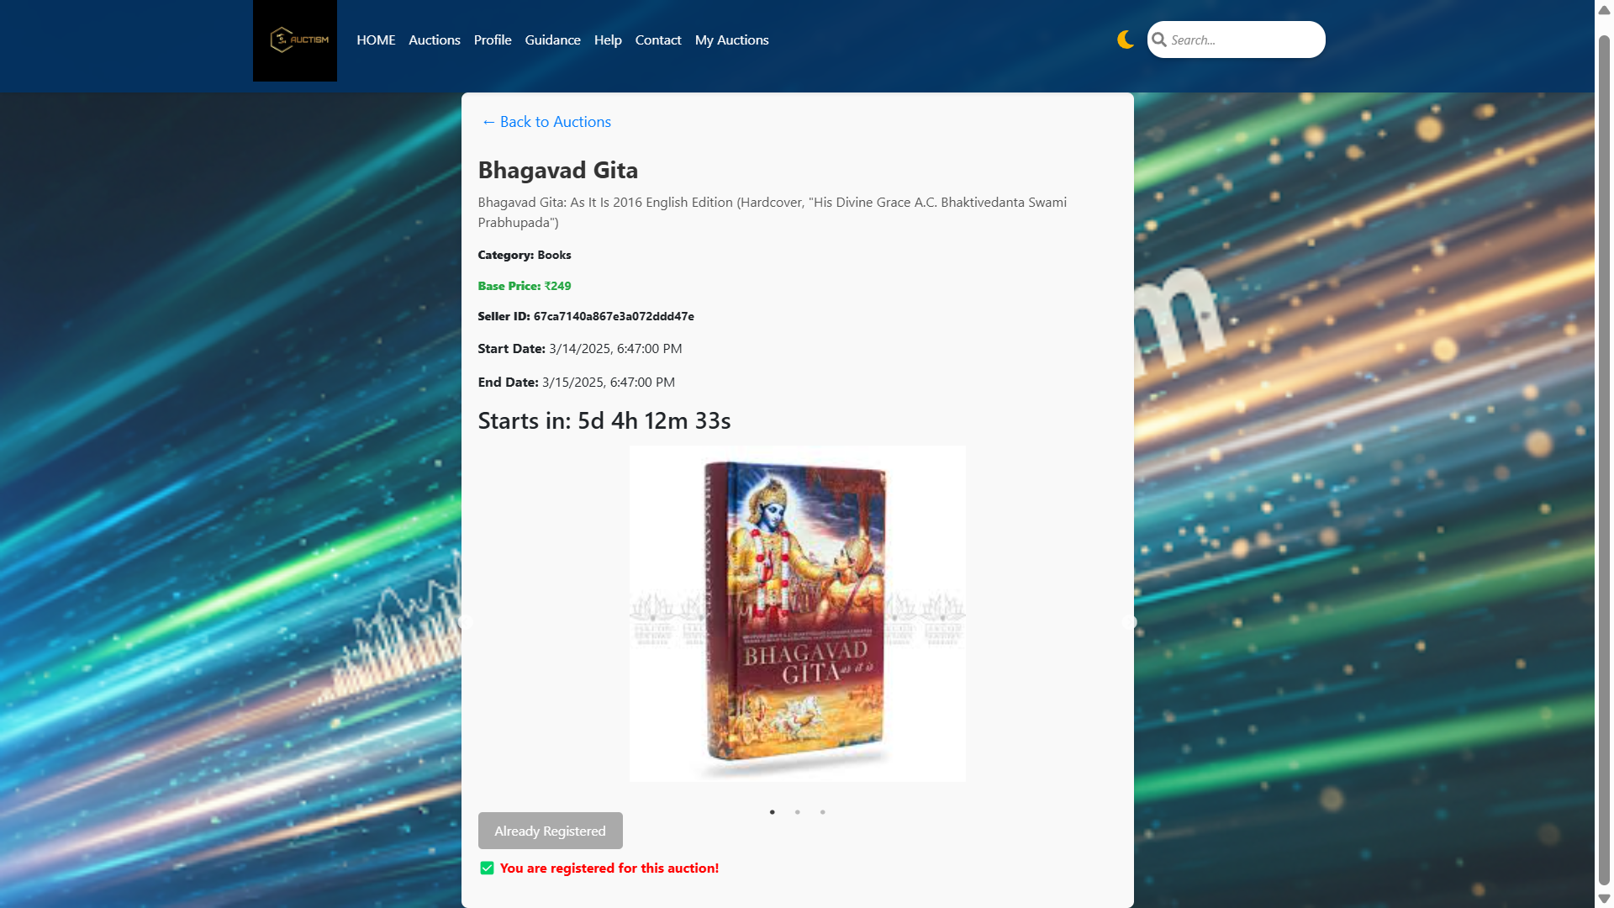
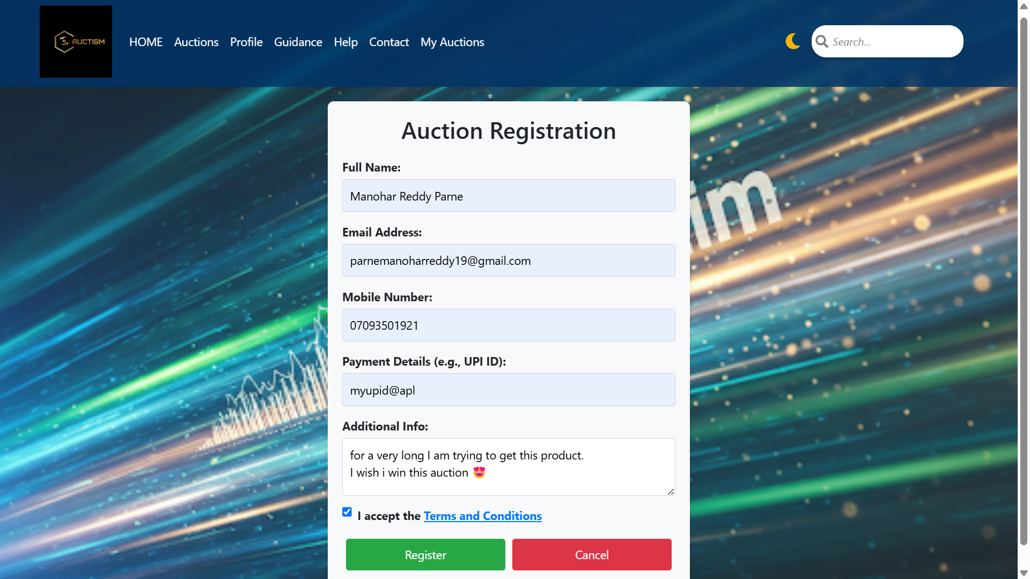
Modelling & Result
Fig 15: Auction Registration Submission
This screenshot shows the registration process after filling in the details and clicking the register button.(select the checkbox).
Fig 16: Successful Auction Registration
This screenshot shows that after filling in the details and clicking the register button, the user is redirected back to the auction’s detailed view, now marked as registered.

Slide 15

Auctism is a comprehensive auction platform built on the MERN stack, integrating real-time bidding with WebSocket and secure access via JWT and Google Auth.
Its interactive UI ensures smooth navigation from registration to live auction participation, simplifying the auction process.
The project addresses key challenges in traditional auctions while providing a scalable foundation for future enhancements.
Explore the live demo at https://auctism-frontend.onrender.com/.
Conclusion

Slide 16


Notes:
Thank You !!

